Slide 1
Market price predictor
Presented by Jesse Pettis

Slide 2
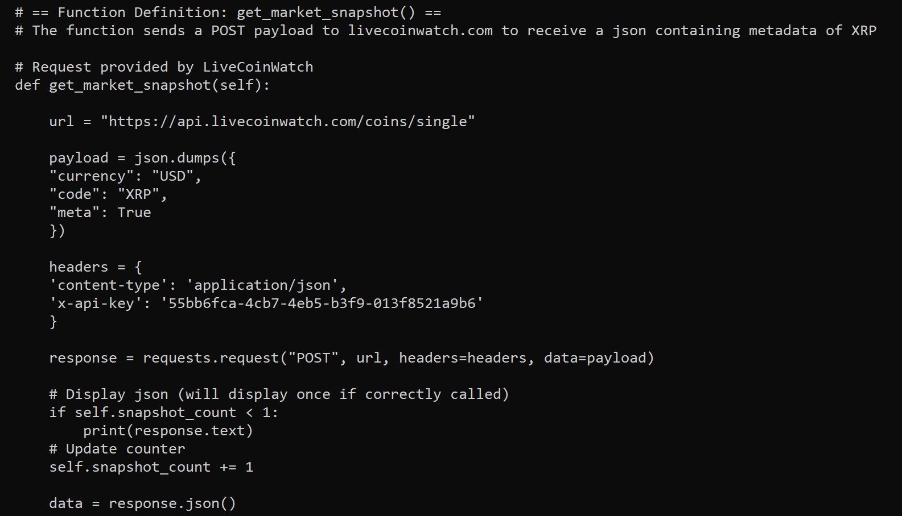
Data collection
API and request pulled from LiveCoinWatch
Sends request to LiveCoinWatch API
Retrieves real-time market data of XRP
Converts JSON into a Python dictionary
Extracts price and timestamp from API

Slide 3
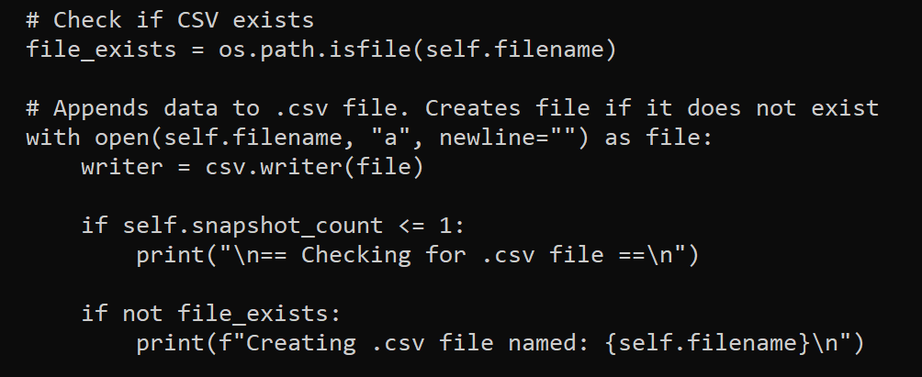
Data storage
OS library for path checking
Stores price changes (delta) to percentage
Appends data from API response to .csv file

Slide 4
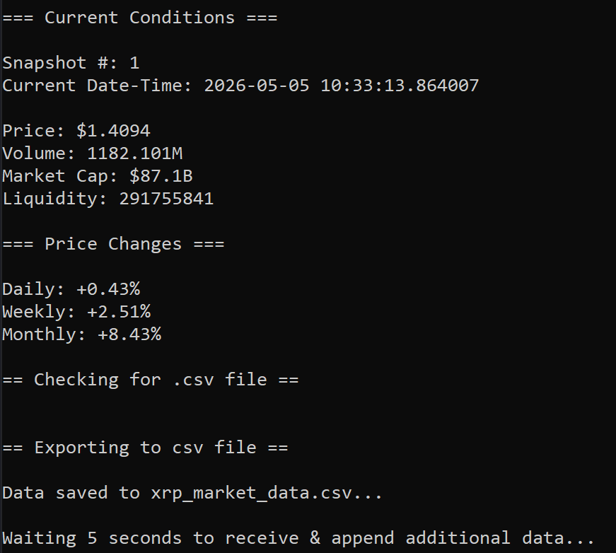
visualization
Datetime library for timestamping
Price changes (deltas) converted to percentage
Fetches new data every 5 seconds

Slide 5
Visualization
Read .csv file using pandas
Price plotted per market snapshot
Chart updated every 5 seconds

Slide 6
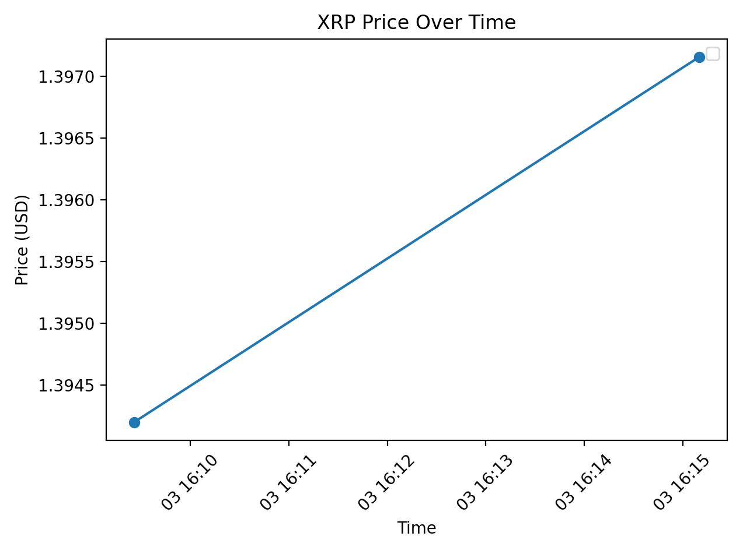
visualization
Each point represent a timestamp of live market data
The line displays how XRP price changes over time
Price trend shows as more data is collected

Slide 7
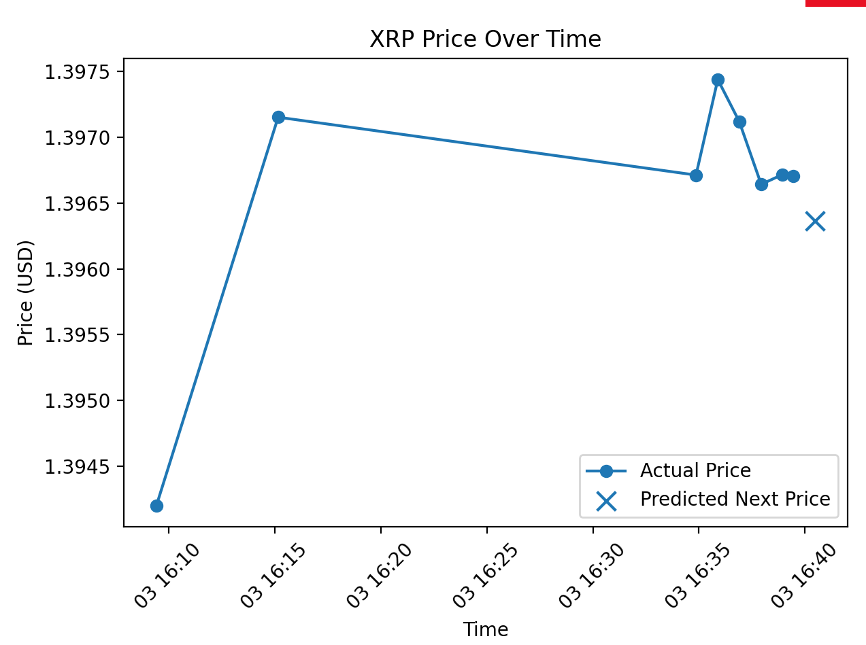
prediction logic
Uses pandas to read from .csv file
Uses NumPy (polyfit) to apply linear regression and estimate the next short-term price

